Slide 1
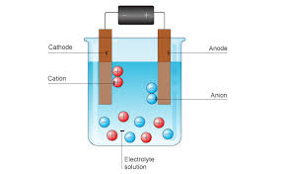
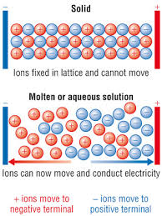
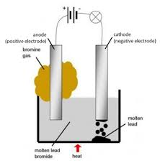
Core focus
Electrolysis
Big idea: Chemical reactions make useful products
Electrolysis
Passing an electric current through electrolytes causes the ions to move to the electrodes. Positively charged ions move to the negative electrode (the cathode), and negatively charged ions move to the positive electrode (the anode).
Ions are discharged at the electrodes producing elements.
This process is called electrolysis.
The metal ions (positive ions) move to
the negative electrode (cathode) and
gain electrons. The metal is formed.
All learners
HT only
Triple science only
Key Vocabulary
anode | The positive electrode where oxidation (loses electrons) happens in electrolysis
cathode | The negative electrode where reduction (gains electrons) happens in electrolysis
discharge | To become neutral by losing or gaining electrons
electrode | The conductive rods
electrolysis | Ionic compounds being decomposed using electricity
electrolyte | An electricity conducting liquid
inert electrodes | These are eletrodes that do not react but allow electrolysis to happen
Ions free to move (MOLTEN or AQUEOUS)
When an ionic compound is
melted or dissolved in water, the
ions are free to move about
within the liquid or solution.
These liquids and solutions are
able to conduct electricity and
are called electrolytes.
Extraction of metals
Metals can be extracted from molten compounds using electrolysis.
Electrolysis is used if the metal is too reactive to be extracted by reduction with carbon or if the metal reacts with carbon. Large amounts of energy are used in the extraction process to melt the compounds and to produce the electrical current.
Aluminium is manufactured by the electrolysis of a molten mixture of aluminium oxide and cryolite using carbon as the positive electrode (anode).
The positive electrode must be continually replaced because the oxygen gas produced reacts with the carbon to turn it into carbon dioxide gas.
Electrolysis of Molten ionic compounds
When a simple ionic compound (eg lead bromide) is electrolysed in
the molten state using inert electrodes, the metal (lead) is produced
at the cathode and the
non-metal (bromine)
is produced at the
anode.

Slide 2
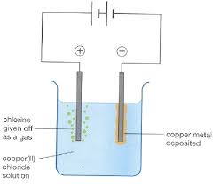
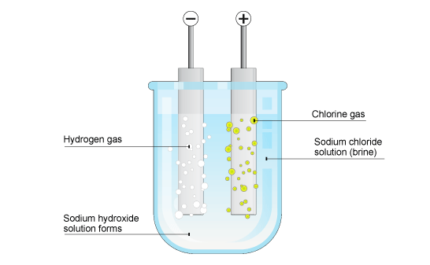
Core focus
HT only
Required Practical – Electrolysis of Aquous Solutions
Diagrams of Observations
Results Table
All learners
Triple science only
Writing Half-Equations
During electrolysis, at the cathode (negative electrode), positively
charged ions gain electrons and so the reactions are reductions.
At the anode (positive electrode), negatively charged ions lose
electrons and so the reactions are oxidations.
Reactions at electrodes can be represented by half equations, for
example:
2H⁺ + 2e⁻ → H₂
and
4OH⁻ → O₂ + 2H₂O + 4e⁻
or
4OH⁻ – 4e- → O₂ + 2H₂O
Electrolysis of Aquous Solutions
The ions discharged when an aqueous solution is electrolysed using
inert electrodes depend on the relative reactivity of the elements
involved.
At the negative electrode (cathode), hydrogen is produced if the metal is more reactive than hydrogen.
At the positive electrode (anode), oxygen is produced unless the solution contains halide ions when the halogen is produced.
This happens because in the aqueous solution water molecules break down producing hydrogen ions and hydroxide ions that are
discharged.
Solution | Positive electrode (anode) |  | Negative electrode (cathode)
 | Observations | Element formed | Observations | Element formed
Copper (II) chloride | Gas produced. Litmus bleached. | Chlorine gas | Red solid on the electrode | Copper metal
Copper (II) sulfate | Gas produced but no change to the litmus. | Oxygen Gas | Red solid on the electrode | Copper metal
Sodium chloride | Gas produced. Litmus bleached. | Chlorine gas | Gas produced but no change to the litmus. | Hydrogen Gas
Sodium sulfate | Gas produced but no change to the litmus. | Oxygen Gas | Gas produced but no change to the litmus. | Hydrogen Gas

